Slide 1

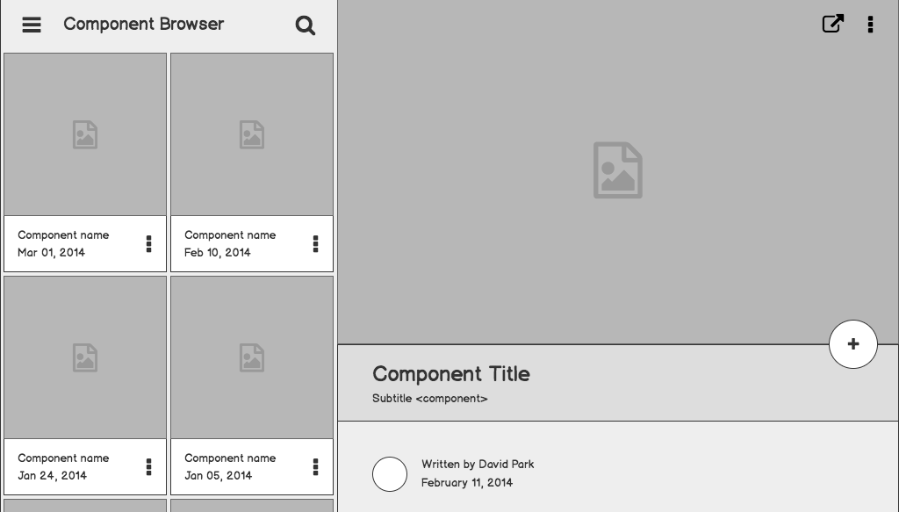

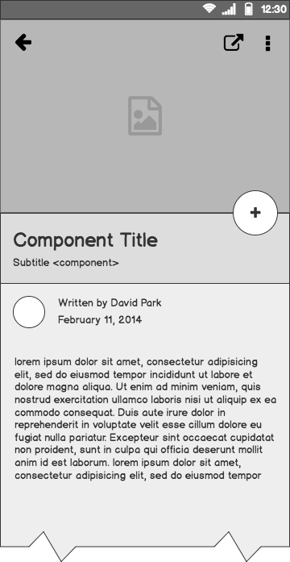
LEGO DOE PROJECT
By Team 102
YU CHENG CHANG
Srihitha Donta
Jeffrey John Kennedy
Ujwala Kavya Jayarama

Slide 2
contents
Introduction and Experimental setup
Design of Experiments
Analysis
Results and Insights
Re modelling
summary

Slide 3
Introduction

Slide 4
Objective
The main objective is to design a race car using Lego blocks that can travel the maximum distance down a ramp.

Slide 5
Factors and Response varaible
Factors:
Axle base
Wheel Base
Wheel size
Weight distribution
Response variable:
Y - distance travelled by the car down the ramp(in cm)

Slide 6
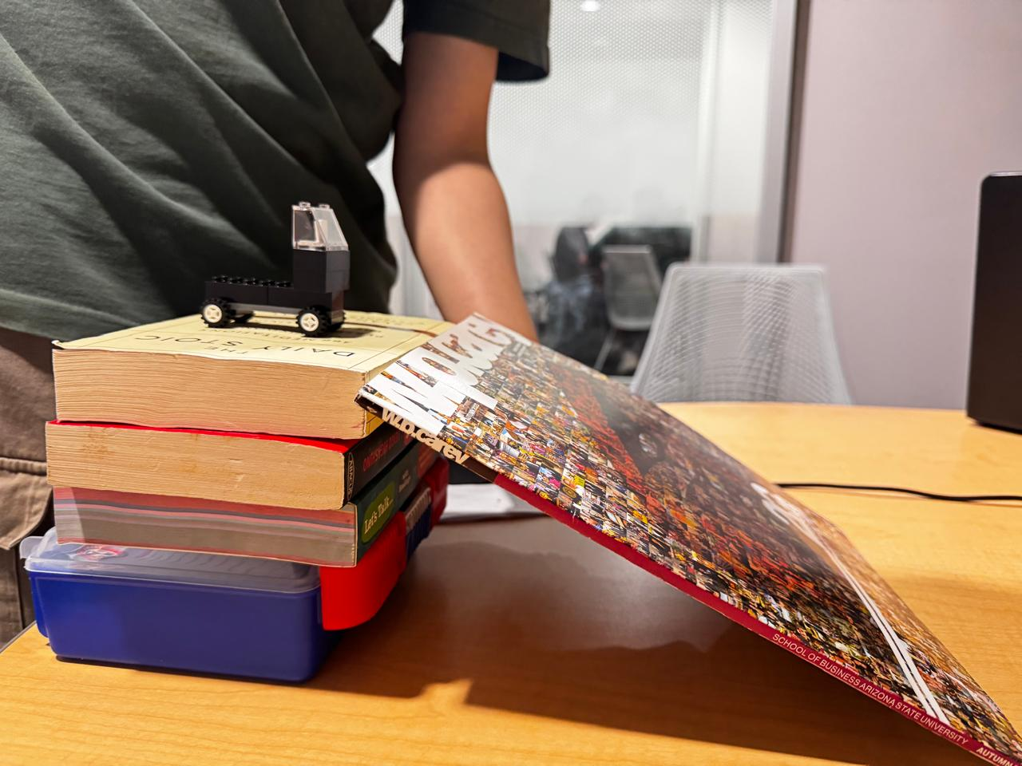
Experimental setup
Makeshift ramp specifications:
Height - 15 cm
Length - 30 cm
Angle - 30 degrees

Slide 7
Constraints
Only use the provided Lego blocks
Every design must have a windshield and steering wheel

Slide 8
Design of Experiments

Slide 9
Full Factorial Analysis
 | Low | High
Wheel Base | 3.5 cm | 5 cm
Axle Base | 1.5 cm | 3.4 cm
Wheel size | small | big
Weight Distribution | Back | Front

Slide 10
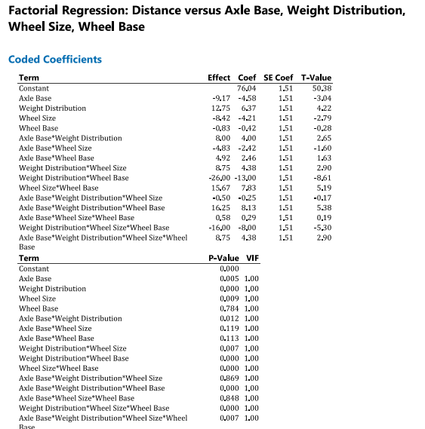
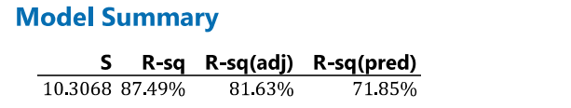

Slide 11
Remodelling

Slide 12
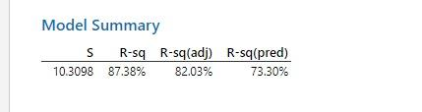
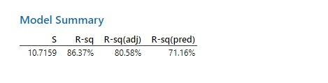
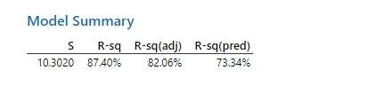
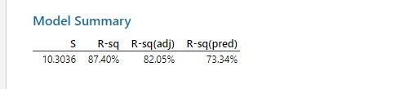
Removing Non-Significant Variables
Removing wheel base
Removing Axle-base * wheel size
Removing axle base* wheel base
Removing base*weight distribution* wheel size
Removing base*wheel size*wheel base

Slide 13
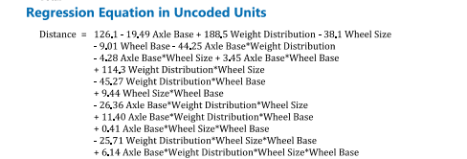
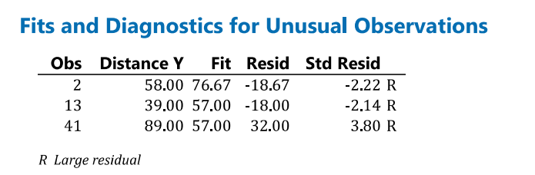
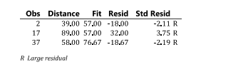

Slide 14
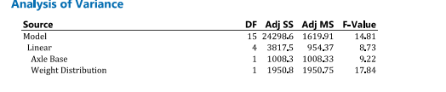
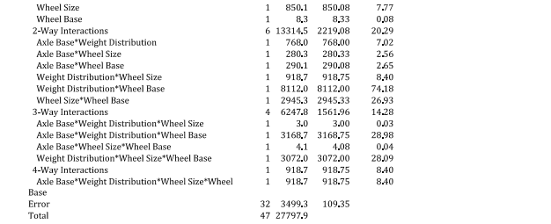

Slide 15
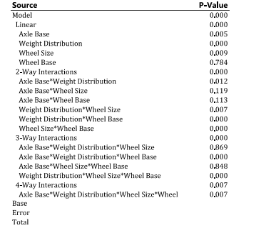

Slide 16
Analysis

Slide 17
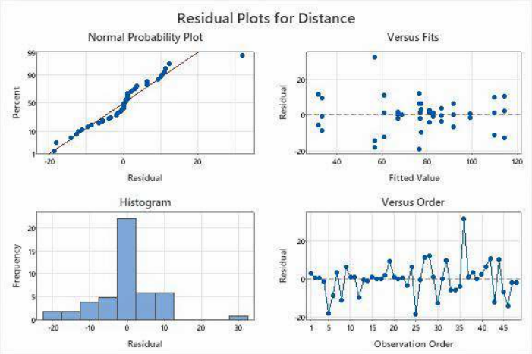

Slide 18
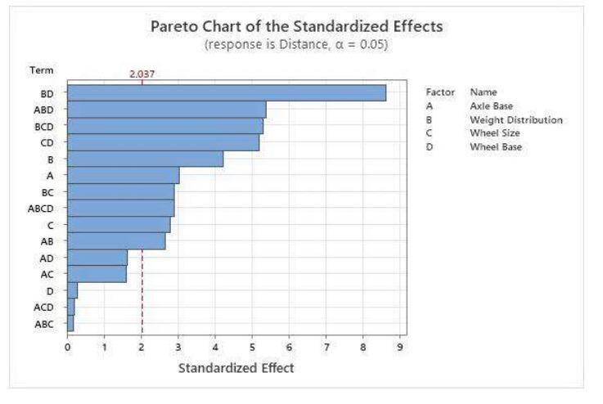

Slide 19
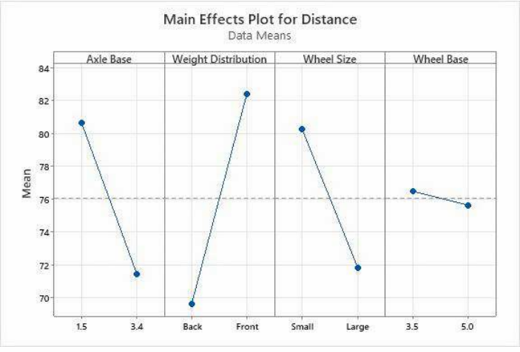

Slide 20
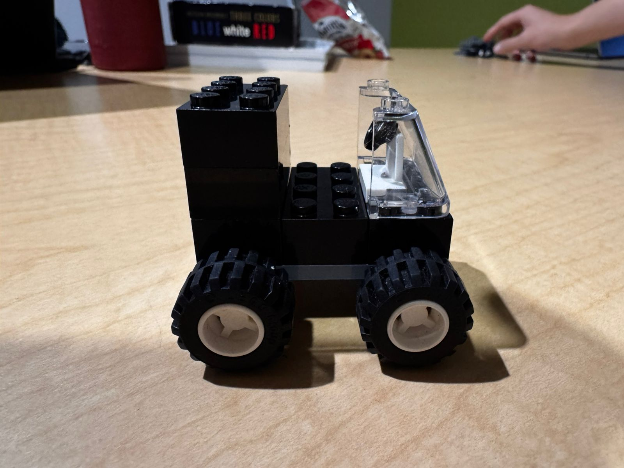
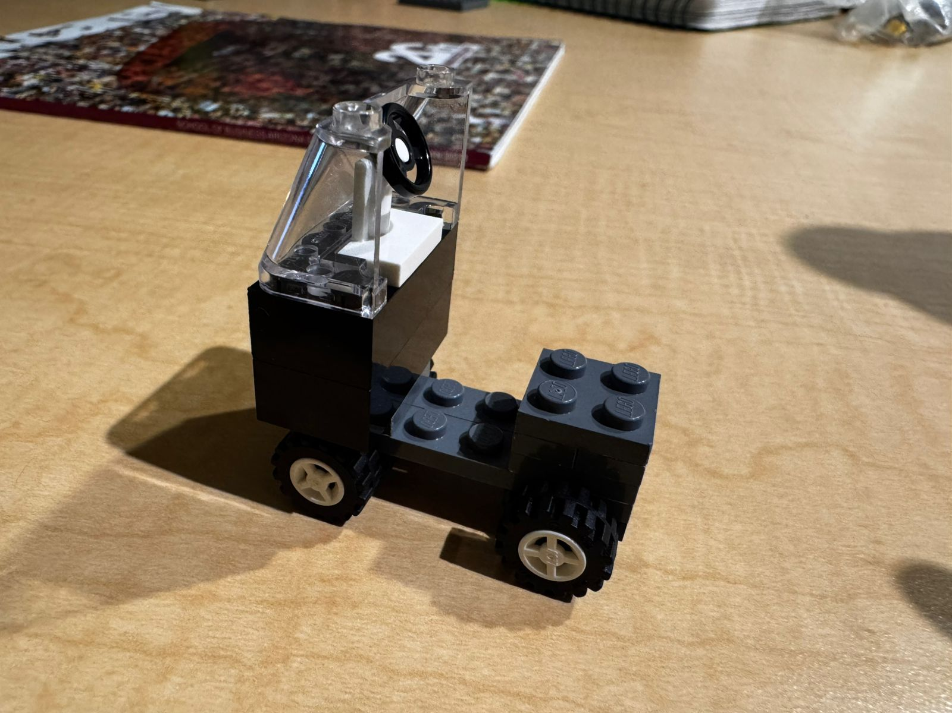
Best performing model
Worst performing model

Slide 21
Insights

Slide 22
Main Effects:
Axle Base and Weight Distribution have the most significant main effects (p-values < 0.01)
Wheel Size shows a marginally significant effect (p-value = 0.130)
Two-Way Interactions:
The interaction between Wheel Base and Axle Base is highly significant (p-value < 0.001)
Wheel BaseWeight Distribution and Weight DistributionWheel Size also show strong interactions
Three-Way Interactions:
Wheel Base and Axle Base and Wheel Size interaction is significant (p-value < 0.001)
Axle BaseWeight DistributionWheel Size also shows a significant effect

Slide 23
Model diagnostics
The model demonstrates strong predictive power with an R-squared value of 87.49%, indicating that it explains a large portion of the variability in the data.
All factors and interactions have a Variance Inflation Factor (VIF) of 1.00, indicating no multicollinearity issues
Three observations (2, 13, and 41) have large standardized residuals, potentially indicating outliers
Intuitively when the weight is added on the back the distance travelled should have been more but in our experiment we got the models works better when the weight is added at the front this could be due to data discrepancy.

Slide 24
Summary

Slide 25
Challenges
Ramp was uneven
The hands had to be stable

Slide 26
This experiment showed that a smaller axle base (1.5), front weight distribution, and smaller wheel size improved the LEGO car’s travel distance by reducing resistance and improving energy. While wheelbase (3.5 or 5.0) had little effect, removing any factors caused the R² value to drop, meaning all factors contribute to performance. Focusing on axle base, weight distribution, and wheel size is key, but all factors should be considered for a complete analysis.

